Slide 1
Notes to the Presenter
Slides 2-10 contain notes for the presenter and are hidden.
You may include your picture and company logo on the intro slide only
It is appropriate to provide a brief background (1 minute or less) on your organization.

Slide 2
Presentation Best Practices
Frame your presentation by answering:
What do you want your audience to learn?
What do you want your audience to do differently?
What result or outcomes do you want your audience to realize?
Clarify your session objectives at the beginning of your presentation.

Slide 3
Presentation Best Practices
Pictures speak 1,000 words; include a screenshot or picture on each slide to add visual interest.
A good goal is to aim for 7 words per slide.
Increase attention and interaction by using a variety of communication mediums, such as polls and videos.
Plan and follow a rough agenda including a breakdown by minute to help stay on track.

Slide 4
Example of Text Layout
Main topic 1: size 28pt
Size 24pt for the subtopics
Size 24pt for the subtopics
Main topic 2: size 28pt
Size 24pt for the subtopics
Size 24pt for the subtopics
Main topic 3: size 28pt
Size 24pt for the subtopics
Size 24pt for the subtopics

Slide 5
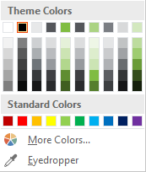
Slide Palette Info
The PowerPoint palette for this template has been built for you and is shown below. Avoid using too many colors in your presentation.
Select the 4th color from the left for subheads and 1st level non-bulleted text color, or wherever “color” text is preferred over the default black/white text
Accent colors 1-6 – (6 Theme Colors to the far right)
Text
Dark 2
Accent 1
Accent 2
Accent 3
Accent 4
Accent 5
Accent 6
Use Accent 1 as the main accent color. Use Accent 2 and Accent 3 when additional colors are needed.
Use Accents 4-6 sparingly – only when more colors are necessary.

Slide 6
Chart Example

Slide 7
Lots of data? Minimalize and Plan
Gray is used to de-emphasize data that is less important. Use cool gray 3 or cool gray 7. See slide 7 for color formulas.
All elements have the same interior margins as text blocks.
When a chart or graphic, has more elements than can easily be aligned to the grid, align the outer edges of the group, top, bottom, left and right edges to the grid.
It is preferable to keep the group aligned to the left border.
130M
140M
125M
Other
Other
Other
Other
Other
Other

Slide 8
Chart Example

Slide 9
Notes (hidden)
Some speakers like to use this slide for hidden “notes slides”.
Delete it if you don’t want to use it.

Slide 10



GLOBAL POWER PLATFORM BOOTCAMP
Organized Globally, Held Locally

Slide 11
STORYTELLING WITH DATA
DAVID ABU

Slide 12
STORYTELLING WITH DATA
DAVID ABU

Slide 13

Speaker
David Abu
Power BI Trainer , Office 365 @ dbrownconsulting
@iamitama
https://www.linkedin.com/in/davidabu
www.dbrownconsulting.net
www.OfficeTrainingHub.com
Notes:
David Brown.

Slide 14
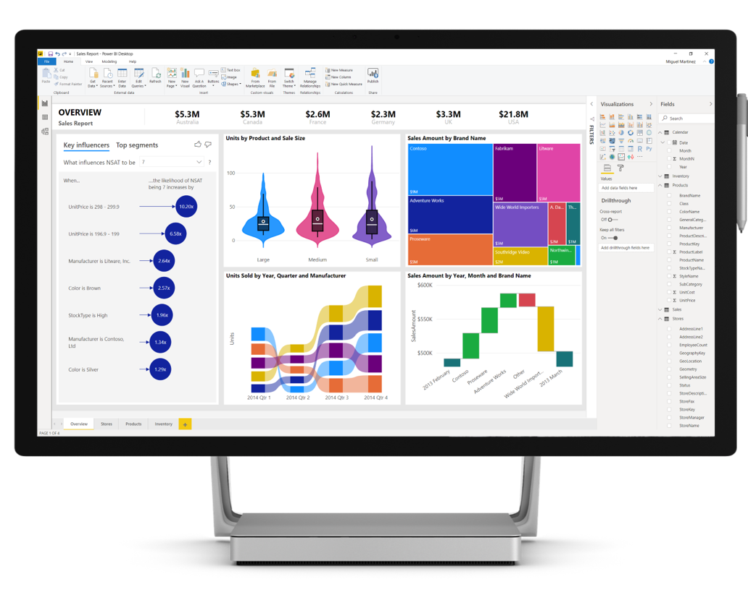
So what is Power BI Desktop?

Slide 15
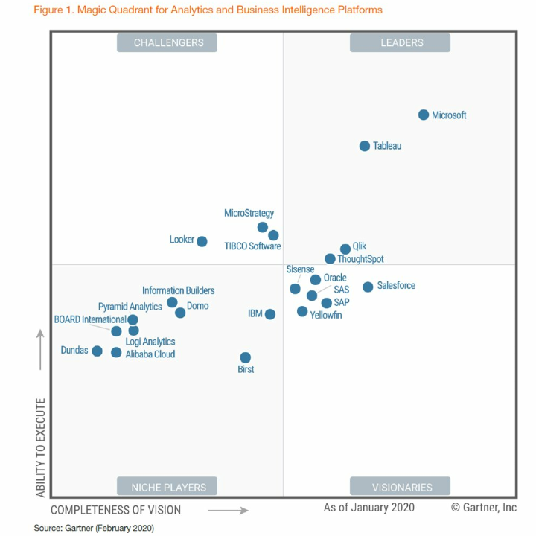
Indusry Industry Leaders in Business Intelligence

Slide 16
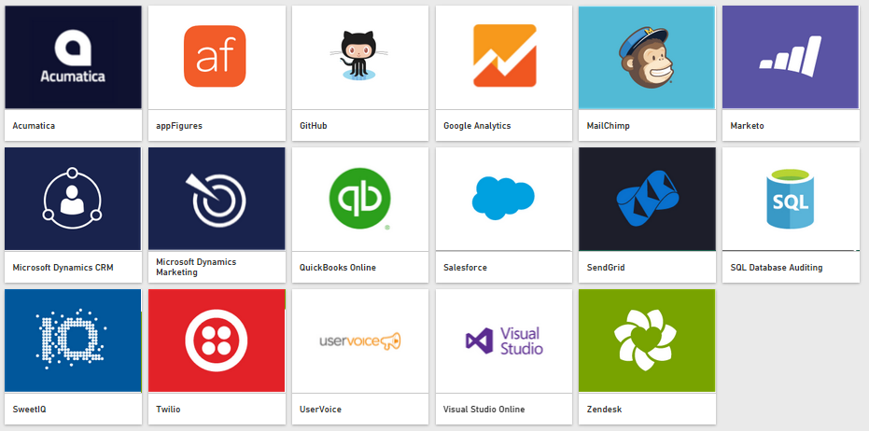
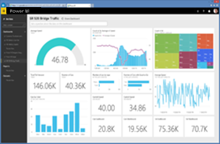
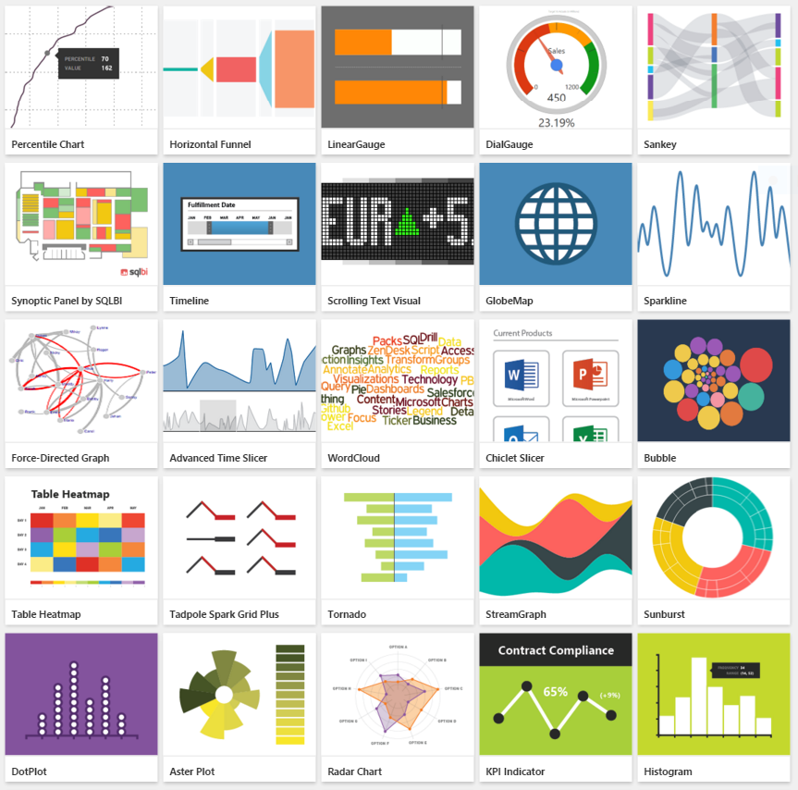


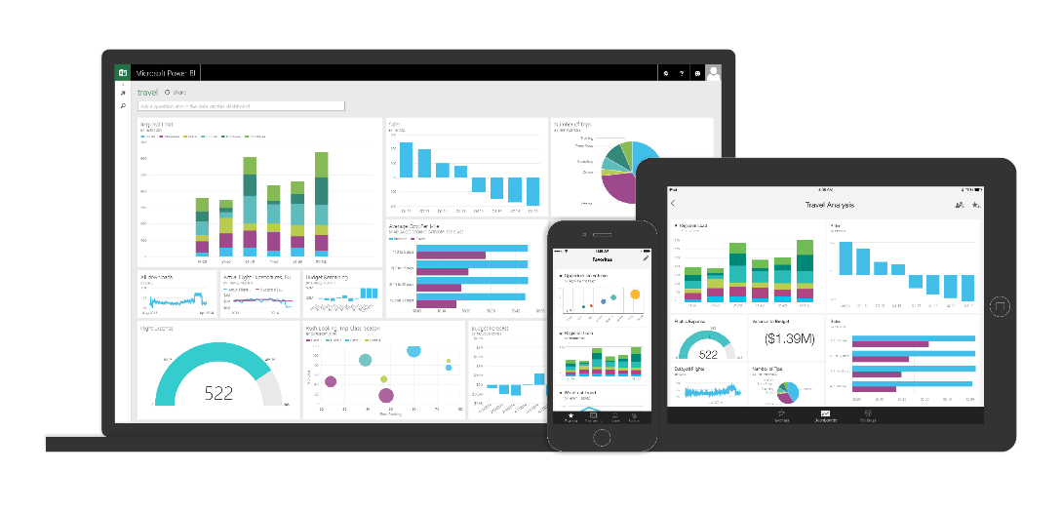









Power BI: Business Intelligence for Everyone
Bring your data together in new ways, wherever it is, yourself
Live 360º view of your business
Unmatched user experience
Natively integrated with apps + services that matter to you
Begin visualizing your data in minutes, yourself
See your data update in real time
You choose how to experience your data
Platform for BI integrating with Office, Azure, and third-party
Data Warehouse
Internet of Things
Big Data
Advanced Analytics
Connect live to your on-premises data
The above quotes were published by Gartner, Inc. as part of a larger research document and should be evaluated in the context of the entire document. Reprints of the documents are available upon request from Microsoft. Gartner does not endorse any vendor, product or service depicted in its research publications, and do not advise technology users to select only those vendors with the highest ratings or other designation. Gartner research publications consist of the opinions of Gartner’s research organization and should not be construed as statements of fact. Gartner disclaim all warranties, expressed or implied, with respect to this research, including any warranties of merchantability or fitness for a particular purpose
Notes:
Power BI is a cloud-based business analytics service that enables anyone to visualize and analyze data with greater speed, efficiency, and understanding. It connects users to a broad range of live data through easy-to-use dashboards, provides interactive reports, and delivers compelling visualizations that bring data to life.
Power BI differentiates from the competitors in 5 unique areas:
industry leadership
self-service live connections to a variety of data sources on prem or in the cloud,
live 360 degree view of your business on the web as well as on your phone or tablet running a native app
unparalleled user experience, from the ability to use custom visuals (i.e., user community contributed visuals built on top of an open source visualization stack from Microsoft) to taking advantage of your personal digital assistant Cortana to ask questions of your data in natural language
native integration with apps + services that you rely on for your business, e.g., integration with Office & Azure to create a platform for business intelligence, embedding in other apps + service, i.e., bring your own visuals inside your favorite apps + services
Industry Leadership
Gartner’s Magic Quadrant for Business Intelligence and Analytics Platforms, February 2016
Leader in MQ for 9th consecutive year
Placed furthest in vision
Also leader in Agile BI by Forrester, September 2015 and PC Magazine’s Editor’s Choice Award December 2015
Bring your data together in new ways, where it is, yourself (self service)
Multiple direct connectors to the most popular data sources, e.g., Excel, SQL, Azure, Oracle, SAP, Salesforce, QuickBooks, etc. Chances are whatever your data source, there’s highly likely a way for you to connect to it yourself
Multiple content packs that provide Pre-built solutions include dashboards, reports, and data models available out-of-the-box for SaaS services or built by your organization. Gets you going quickly to the things that matter: dashboards, reports, etc., rather than getting caught up in figuring out the data connection, data prep, etc.
New connectors and content packs are being added every week
Live 360 view of your business
See your data update in real time on the web or on your devices
Stay connected to your data, i.e., your business, with native apps on your phone or tablet
Native apps on iOS, Android, and Windows – so you can use your favorite device
Unmatched UX
Rich library of built in visuals – more being added frequently – so that you can create the dashboard/report just the way you want it
Custom visuals created by user community built on top of open source visualization stack from Microsoft – the possibilities are endless here in terms of creativity and innovation
Ask questions of your data using natural language, leveraging Cortana capability – going beyond the traditional keyboard & mouse and even touch human machine interaction
Integration with apps + services that matter to you
Integrated with Office & Azure to create a platform for business intelligence. It’s not just about a point solution; it’s a complete end to end platform for business intelligence
Embed your own visuals inside your favorite apps + services to maintain consistency of that dashboard/repot view that everyone in your organization is familiar with and loves – all the while the data behind the scene gets updated and the embedded view inside your favorite apps + services automatically gets updated too

Slide 17






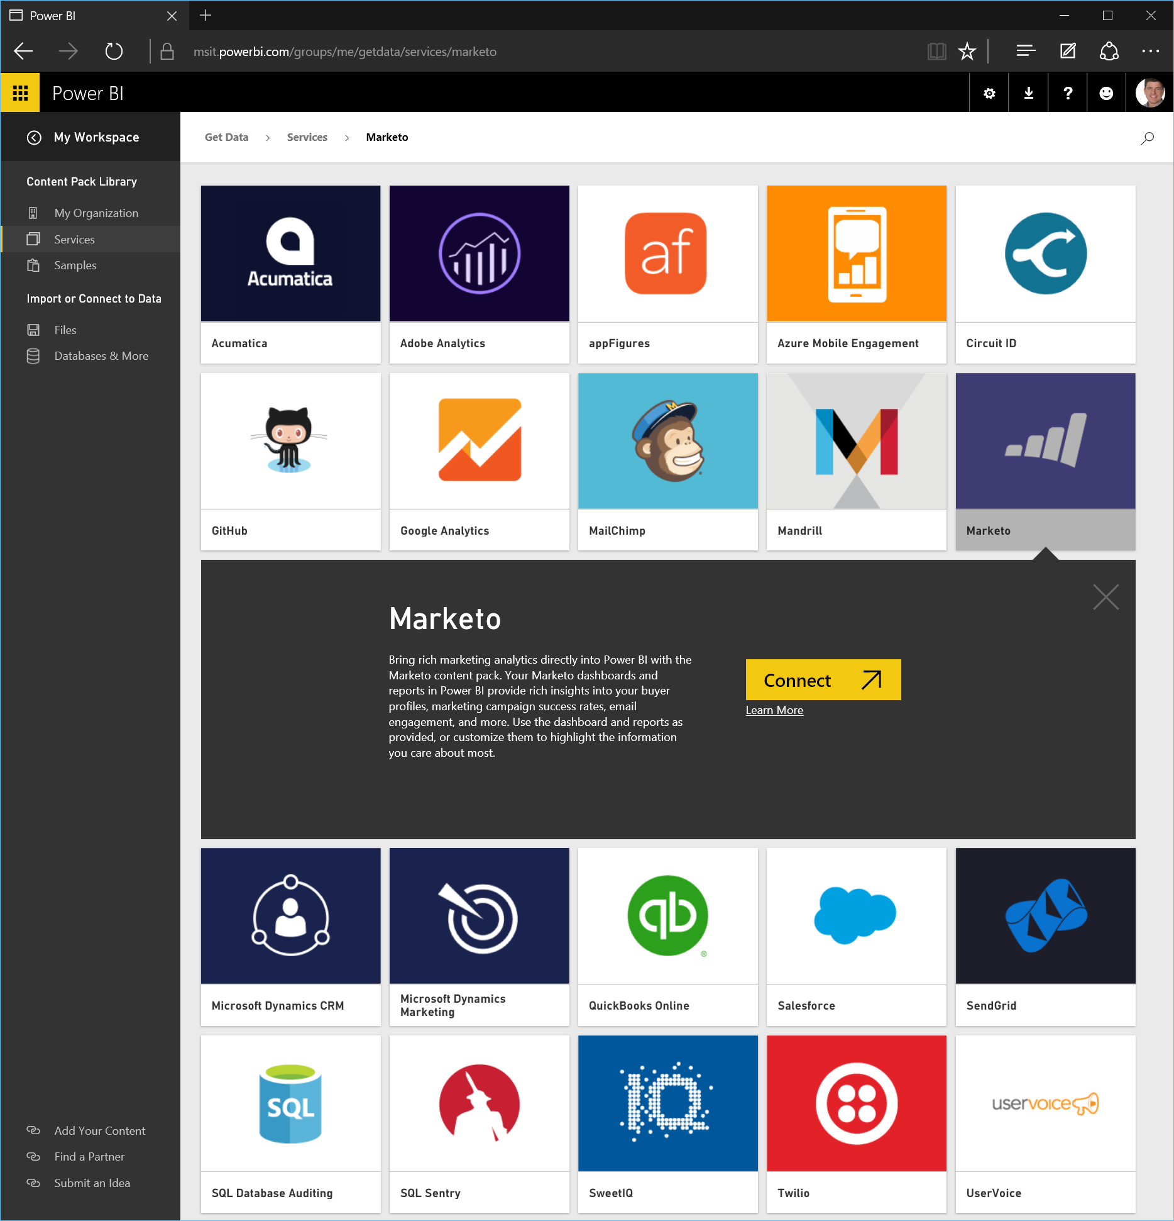



















Get started quickly
Get Started Quickly
Pre-built solutions include dashboards, reports, and data models available out-of-the-box for SaaS services or built by your organization.
Dynamics Marketing
Azure Audit
Logs
Microsoft Dynamics NAV
Azure Mobile
Engagement
Application
Insights
SQL Database
Auditing

Slide 18
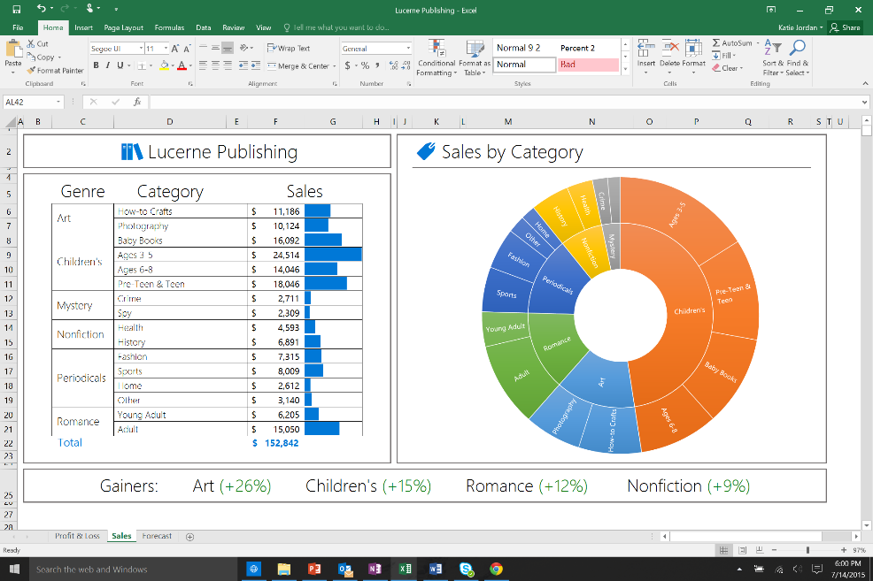
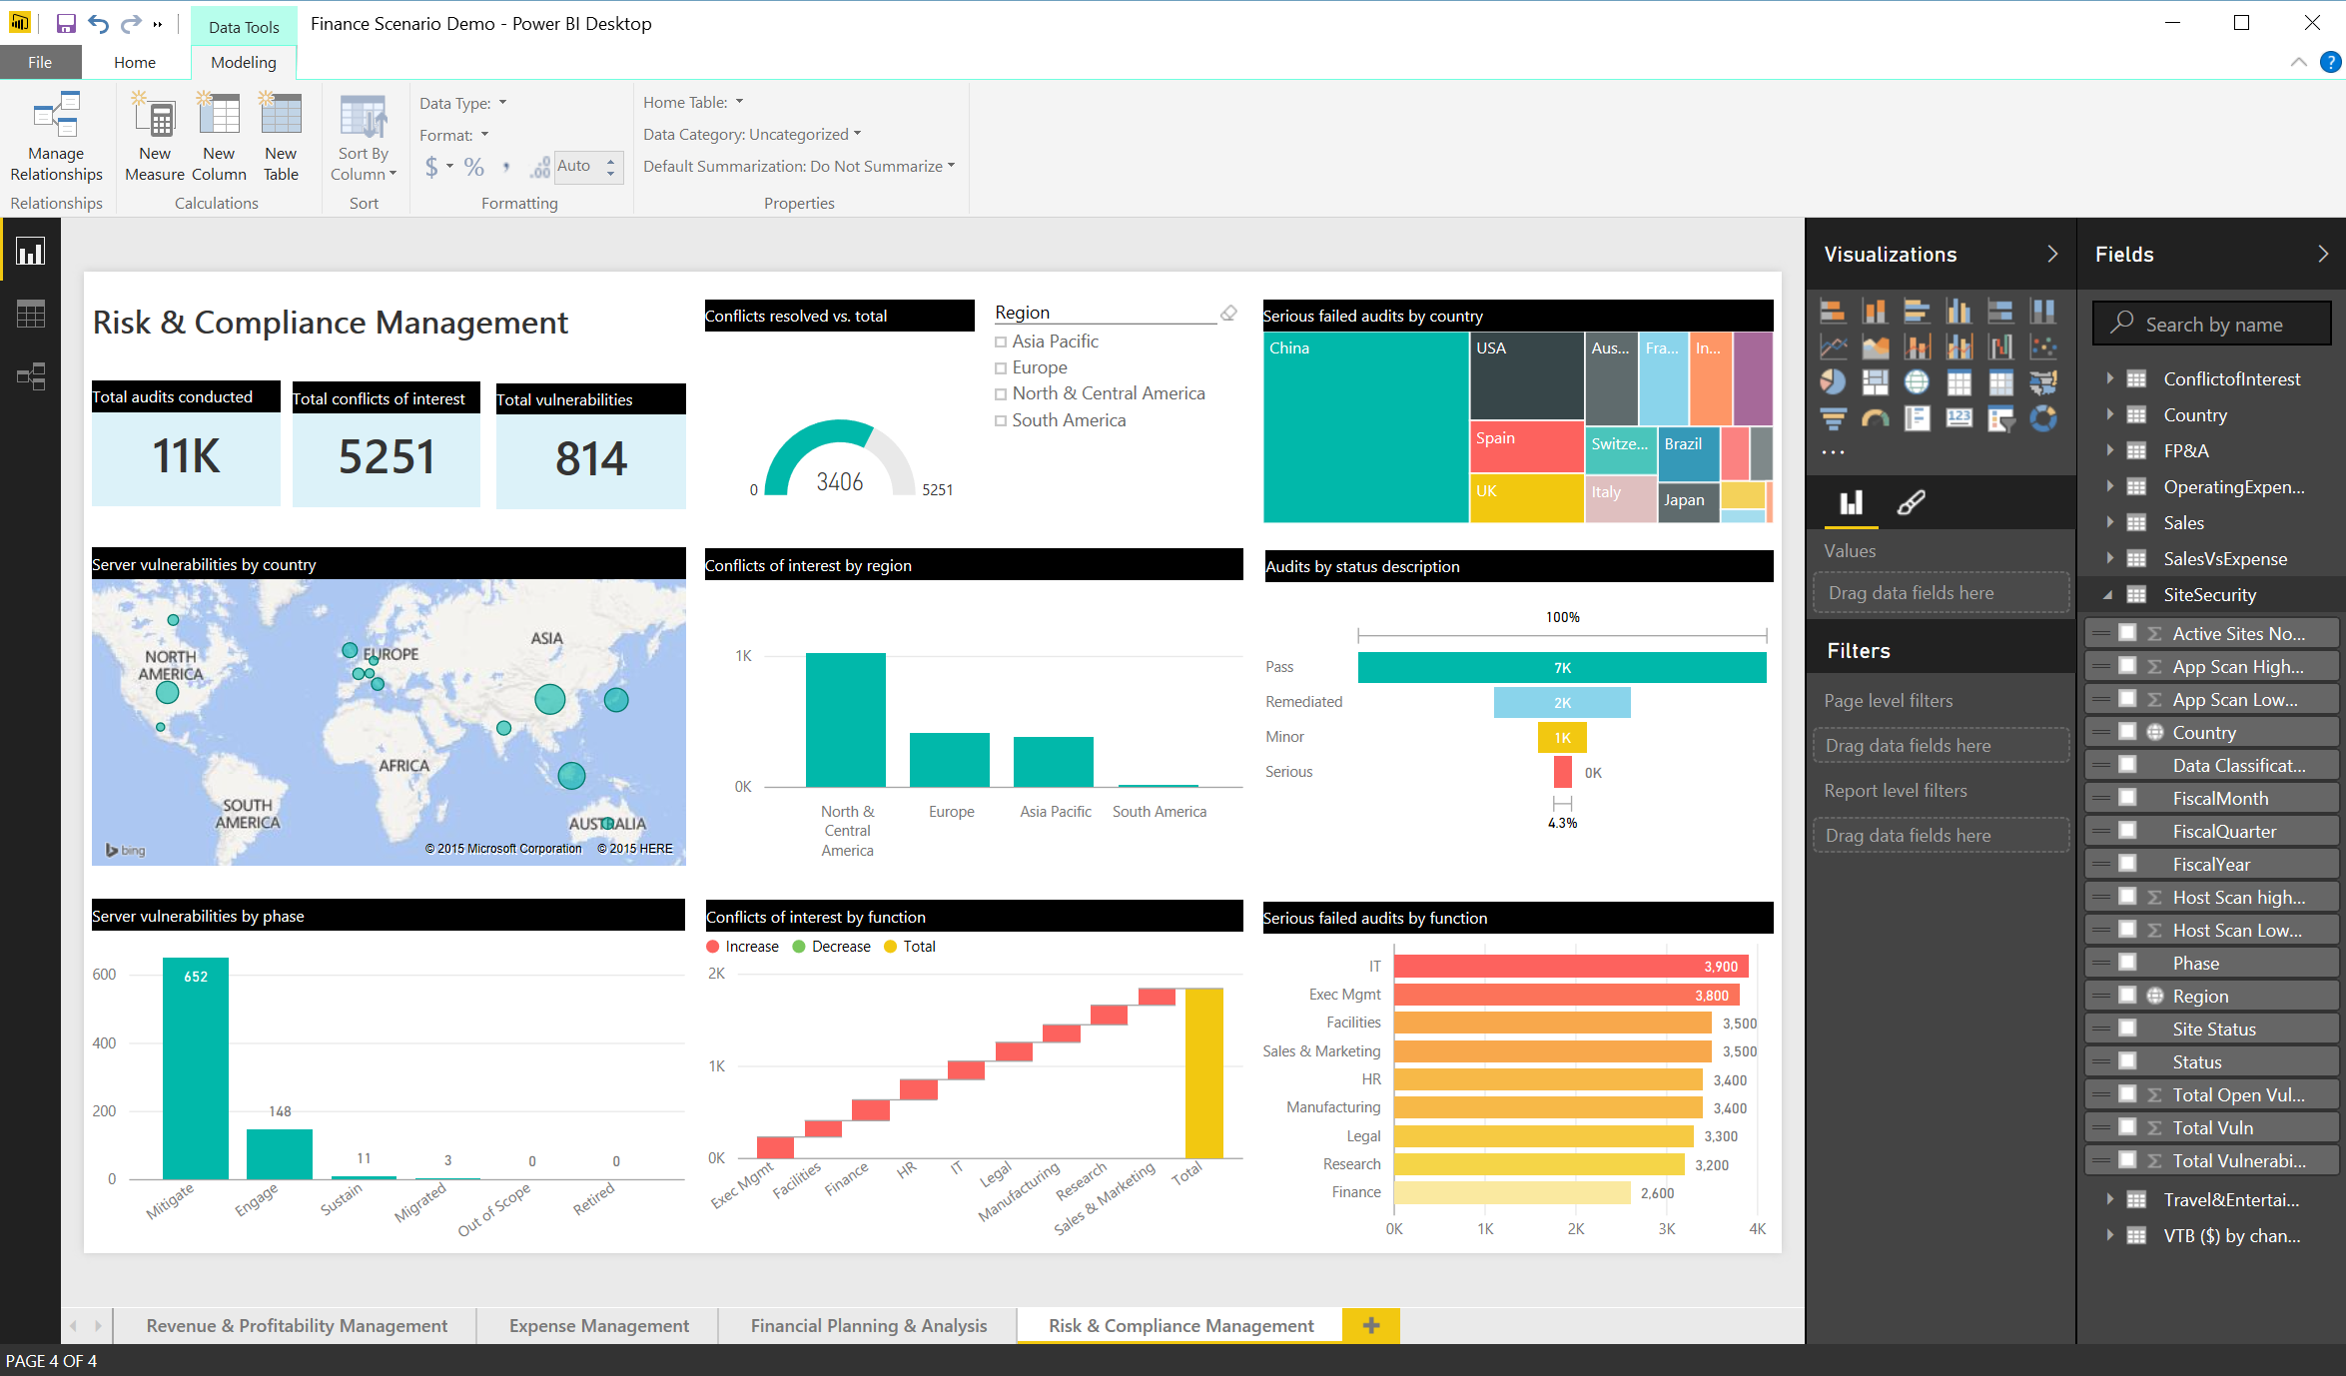
Powerful self-service business analysis
SPREADSHEETS
Familiar data preparation experience across tools
Connectors for a broad range of data sources
Create analytical spreadsheets and interactive visual reports
One click publishing to Power BI
Excel
INTERACTIVE REPORTS
Power BI Desktop

Slide 19
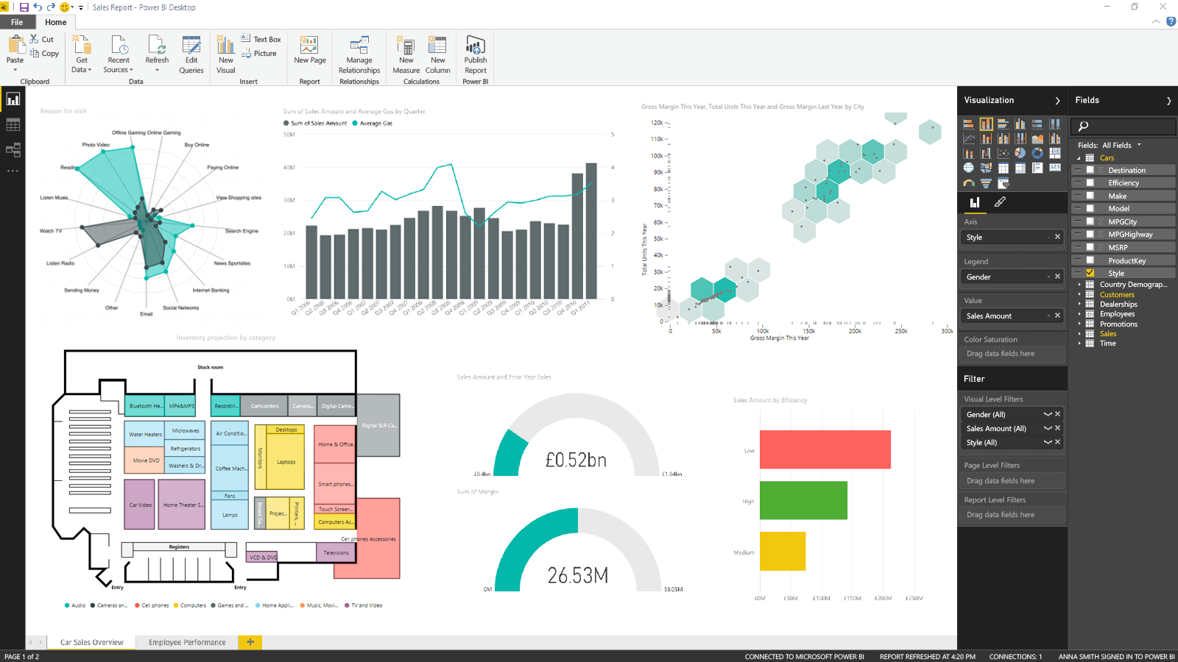
Create Power BI interactive reports
Power BI Desktop
Data discovery & exploration – through powerful data prep and freeform drag-and-drop canvas designed for visual data exploration.
Interactive reports – ease of report authoring and formatting with one click publishing to Power BI.
Custom visuals – import custom interactive visualizations that work and integrate like out-of-the-box visualizations.

Slide 20
POWER BI DEMO

Slide 21
With Power BI… we can immediately integrate information across lines of business—from arena activity to online retail and social engagement—and present that data across mobile devices, desktops, and tablets.”- Matthew Jafarian: Executive Vice President of Business Strategy at Miami HEAT

Slide 22
Any Questions?

Slide 23
Thank You For Attending

